Slide 1
Dimensionality Reduction using R
Dr. Tanujit Chakraborty
Assistant Professor of Statistics
Sorbonne University Abu Dhabi

Slide 2
CONTENTS
SL No. | Today’s Topics
1 | Principal Component Analysis
2 | Factor Analysis
3 | Market Basket Analysis
2

Slide 3
PRINCIPAL COMPONENTS ANALYSIS
3

Slide 4
PRINCIPAL COMPONENTS ANALYSIS
A dimensionality reduction technique
Reduces the dimensionality of multivariate data without compromising much on the variation in the original data set.
Achieved by transforming the original varaible into a new set of variables
namely prinipal components (PCAs)
PCAs are uncorrelated and ordered
Hence the first few of them account for most of the variation in the orignal variables
4

Slide 5
PRINCIPAL COMPONENTS ANALYSIS
Desribes the variation in a set of correlated variables x = (x₁, x₂, - - -, x_{q}) by a
set of uncorrelated variables y = (y₁, y₂, - - -, y_{q})
Each principal component is a linear combination of the x variables.
The new variables are derived in decreasing order of importance.
Hence y₁ account for maximum possible variation in x among all linear combinations of x
y₂ account for maximum possible of the remaining variation subject to being uncorrelated to y1. and so on.
5

Slide 6
PRINCIPAL COMPONENTS ANALYSIS
A dimensionality reduction technique
Large number of correlated variables can be reduced to a manageable number of uncorrelated or independent factors.
The emphasis is on the identification of underlying factors that might explain
the dimensions associated with large data sets
y_{i} = a_{i1}x₁ + a_{i 2} x₂ + a_{i3}x₃ + − − − + a_{iq} x_{q}
Where y_{i}: estimate of i^{th} principal component, a_{i}: weight or score coefficient, x_{i}: i^{th} variable and k: number of variables
The coefficients are selected such that
  the first principal component explains largest portion of the total variation
  the second first principal component accounts for the most of the residual variance, etc.
6

Slide 7
PRINCIPAL COMPONENTS ANALYSIS
Helps to understand the variability in large data sets with inter correlated variables using a smaller number of uncorrelated factors.
Explaining variability of a set of n variables using m factors where m < n
The emphasis is on the identification of underlying factors that might explain
the dimensions associated with large data
Objectives
  Reduces the complexity of a large set of variables by summarizing them in a smaller set of components or factors
  Tries to improve the interpretation of complex data through logical factors
7

Slide 8
PRINCIPAL COMPONENTS ANALYSIS
Computation of sample Principal Components
The first principal component is that linear combination of original variables whose sample variance is greatest amongst all possible such linear combinations
The second principal component is the linear combination of original variables that account for maximum proportion of the remaining variance subject to being uncorrelated with the first principal component and so on
The first principal component is
y₁ = a₁₁x₁ + a₁₂x₂ + a₁₃x₃ + − − − + a_{1q} x_{q}
The variance of y₁ be increased by increasing a₁ = (a₁₁,- - -, a_{1q}), a restriction must be placed on these coefficients.
The sensible restriction or constraint is to ensure that sum of squares of the coefficients should be equal to one
a₁’a₁ = 1
8

Slide 9
PRINCIPAL COMPONENTS ANALYSIS
Computation of sample Principal Components
To choose the elements of a₁ which maximizes the variance of y₁ subject to the constraint of a₁’a₁ = 1
Since y₁ is a linear combination of x, the sample variance of y₁ is given by
Var(y₁) = a₁’Sa₁
where S is the sample covariance matrix of x
The coefficients a₁ of first principal component y₁ is computed by solving Maximize
z = a₁’Sa₁ Subject to
a₁’a₁ = 1
The solution to the above problem (using Lagrange multiplier method) is the Eigen vector of S corresponding to the largest Eigen value of S denoted by λ₁
9

Slide 10
PRINCIPAL COMPONENTS ANALYSIS
Computation of sample Principal Components
In general, the coefficients a_{i} of first principal component y_{i} solving
is computed by
Maximize
z = a_{i}’Sa_{i} Subject to
a_{i}’a_{i} = 1
The solution to the above problem (using Lagrange multiplier method) is the Eigen vector of S corresponding to the i^{th} largest Eigen value of S denoted by λ_{i}
Since a_{i}’a_{i} = 1, the variance of i^{th} principal component y₁ will be λ_{i}
10

Slide 11
PRINCIPAL COMPONENTS ANALYSIS
Steps
Prepare correlation matrix
Extract a set of principal components using correlation matrix
Determine the number of principal components
Interpret results
11

Slide 12
PRINCIPAL COMPONENTS ANALYSIS
Example: Suppose a researcher wants to determine the underlying benefits consumers seek from the purchase of a toothpaste. A sample of 30 respondents was interviewed. The respondents were asked to indicate their degree of agreement with the following statements using a 7 point scale (1: strongly disagree, 7: strongly agree)
It is important to buy a toothpaste that prevents cavities
I like a toothpaste that gives shiny teeth
A toothpaste should strengthen your gums
I prefer toothpaste that freshens breath
Prevention of tooth decay is not an important benefit offered by a toothpaste
The most important consideration in buying a toothpaste is attractive teeth
Dataset: PCA_Factor_Analysis_Example.csv
12

Slide 13
PRINCIPAL COMPONENTS ANALYSIS
Step 1: Normalize the data
z transform:
Transformed data = (Data – Mean) / SD
Reading ghe file to R
>mydata = mydata[,2:7]
Transforming the variables
>myzdata = scale(mydata)
13

Slide 14
PRINCIPAL COMPONENTS ANALYSIS
Step 2: Check for Correlation
Variables must be correlated for data reduction
cor(myzdata)
Correlation Matrix
 |  | x1 | x2 | x3 | x4 | x5 | x6
Correlation | x1 | 1.000 | -.053 | .873 | -.086 | -.858 | .004
 | x2 | -.053 | 1.000 | -.155 | .572 | .020 | .640
 | x3 | .873 | -.155 | 1.000 | -.248 | -.778 | -.018
 | x4 | -.086 | .572 | -.248 | 1.000 | -.007 | .640
 | x5 | -.858 | .020 | -.778 | -.007 | 1.000 | -.136
 | x6 | .004 | .640 | -.018 | .640 | -.136 | 1.000
High correlation between x₁, x₃ & x₅
Good correlation between x₂, x₄ & x₆
14

Slide 15
PRINCIPAL COMPONENTS ANALYSIS
Step 4: Method used: Principle Component Analysis
mymodel = princomp(myzdata)
>summary(mymodel)
Used to identify minimum number of components accounting for maximum variance in the data ; Eigen Values: Amount of variance attributed to a component.
Total Variance = 6 (Sum of all Eigen values)
Prop. variance for PC1= Eigen value of PC1 / Total Variance (2.731/6 = 0.455)
Component | SD | Variance | Proportion of Variance | Cumulative Proportion of Variance
PC 1 | 1.653 | 2.732 | 0.455 | 0.455
PC 2 | 1.489 | 2.217 | 0.369 | 0.825
PC 3 | 0.665 | 0.442 | 0.074 | 0.899
PC 4 | 0.584 | 0.341 | 0.057 | 0.955
PC 5 | 0.427 | 0.182 | 0.030 | 0.986
PC 6 | 0.292 | 0.085 | 0.014 | 1.000
Total |  | 6.000

Slide 16
PRINCIPAL COMPONENTS ANALYSIS
Step 4: Determine the number of Components
Based on Eigen Values: Only components with Eigen value > 1.0 or Eigen value > 0.7 are selected.
Based on cumulative % variance: Factors extracted should account for at
least 65 % of variance
Component | SD | Variance | Proportion of Variance | Cumulative Proportion of Variance
PC 1 | 1.653 | 2.732 | 0.455 | 0.455
PC 2 | 1.489 | 2.217 | 0.369 | 0.825
PC 3 | 0.665 | 0.442 | 0.074 | 0.899
PC 4 | 0.584 | 0.341 | 0.057 | 0.955
PC 5 | 0.427 | 0.182 | 0.030 | 0.986
PC 6 | 0.292 | 0.085 | 0.014 | 1.000
Total |  | 6.000
Number of factors selected : 2

Slide 17
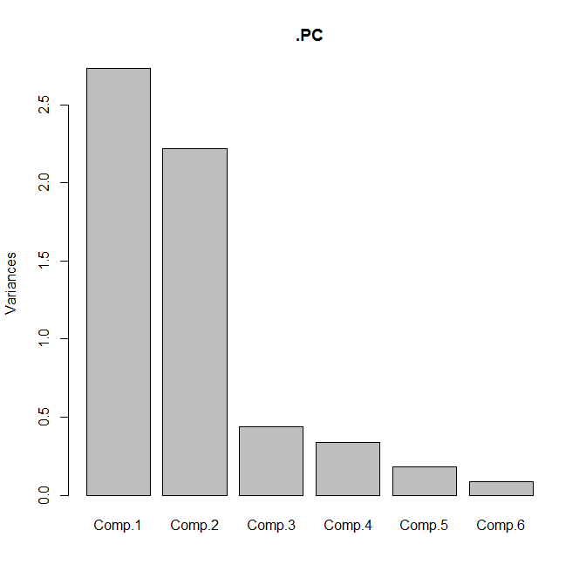
PRINCIPAL COMPONENTS ANALYSIS
Step 4: Determine the number of Factors
>plot(mymodel)
3. Based on Scree plot: Plot of the Eigen values against the number of factors in order of extraction. The number of components is identified based on slope change of scree plot
Number of factors selected : 2
18

Slide 18
PRINCIPAL COMPONENTS ANALYSIS
Step 5: Calculate Component Scores– Eigen Vectors
>loadings(mymodel)
y_{i} = a_{i1}x₁ + a_{i 2} x₂ + a_{i3}x₃ + − − − + a_{ik} x_{k}
 | Component
 | y₁ | y₂
x₁ | 0.562 | -0.170
x₂ | -0.182 | -0.534
x₃ | 0.566 | -0.088
x₄ | -0.207 | -0.530
x₅ | -0.526 | 0.236
x₆ | -0.107 | -0.585

Slide 19
PRINCIPAL COMPONENTS ANALYSIS
Step 5: Interpret Components – Eigen Vectors
 | Component
 | y₁ | y₂
x₁ | 0.562 | -0.170
x₂ | -0.182 | -0.534
x₃ | 0.566 | -0.088
x₄ | -0.207 | -0.530
x₅ | -0.526 | 0.236
x₆ | -0.107 | -0.585
Component 1 is correlated with x₁, x₃ & x₅ Component 2 is correlated with x₂, x₄ & x₆

Slide 20
PRINCIPAL COMPONENTS ANALYSIS
Step 5: Interpret Components
 | Component
 | y₁ | y₂
Prevention of Cavities | 0.562 | -0.170
x₂ | -0.182 | -0.534
Strong Gum | 0.566 | -0.088
x₄ | -0.207 | -0.530
Non Prevention of Tooth Decay | -0.526 | 0.236
x₆ | -0.107 | -0.585
Interpretation
Component 1 (y₁) represents the health related benefits

Slide 21
PRINCIPAL COMPONENTS ANALYSIS
Step 5: Interpret Components
 | Component
 | y₁ | y₂
Prevention of Cavities | 0.562 | -0.170
Shiny Teeth | -0.182 | -0.534
Strong Gum | 0.566 | -0.088
Fresh Breath | -0.207 | -0.530
Non Prevention of Tooth Decay | -0.526 | 0.236
Attractive Teeth | -0.107 | -0.585
Interpretation
Component 2 (y₂) represents the social related benefits

Slide 22
PRINCIPAL COMPONENTS ANALYSIS
Step 6: Reduced Data Set
>pc = mymodel$scores
>cbind(pc[,1], pc[,2])
Respondent | PC1 | PC2 | Respondent | PC1 | PC2
1 | 1.953 | -0.071 | 16 | 1.412 | 0.1352
2 | -1.6763 | 0.9852 | 17 | 1.261 | 0.6098
3 | 2.4298 | 0.6577 | 18 | 2.5041 | -0.2372
4 | -0.0908 | -1.6975 | 19 | -1.2981 | 1.3974
5 | -1.5154 | 2.7238 | 20 | -1.2777 | -1.7423
6 | 1.6696 | 0.0148 | 21 | -1.449 | 1.7912
7 | 1.0622 | 1.1536 | 22 | 0.9783 | -0.2455
8 | 2.0882 | -0.5402 | 23 | -1.4107 | 0.8217
9 | -1.29 | 1.3543 | 24 | -0.9281 | -2.6799
10 | -2.7958 | -1.6321 | 25 | 1.4305 | -0.0294
11 | 2.0398 | 0.3893 | 26 | -1.0791 | -2.2053
12 | -1.6682 | 0.9421 | 27 | 1.4698 | 0.106
13 | 2.4379 | 0.6146 | 28 | -1.5875 | -1.2162
14 | -0.4251 | -1.9974 | 29 | -0.8027 | -3.2699
15 | -1.6509 | 1.8801 | 30 | -1.7904 | 1.987

Slide 23
EXPLORATORY FACTOR
ANALYSIS

Slide 24
FACTOR ANALYSIS
Many times it may not be possible to measure some of the concepts directly
Such cases the concepts are examined indirectly by collecting information on variables which can be directly measurable and assumed to be indicators of the concepts of interest.
Example
It is difficult to conclude a student is interested in science or arts directly.
The students scores on science subjects or arts subjects can be an indicator for the students interest in science or arts.
Concepts which cannot be measured directly are called latent variables or factors
The variables which can be directly measured and related to latent variables are called manifest variables

Slide 25
FACTOR ANALYSIS
The method of analysis to uncover the relationship between latent variables and manifest variables is factor analysis
The method is based on multiple regression, except in factor analysis manifest variables is regressed on unobservable latent variables
Types of Factor Analysis: Exploratory and Confirmatory Exploratory Factor Analysis
Used to investigate the relationship between factors and manifest variables without making any assumption about which manifest variables is related to which factors
Confirmatory Factor Analysis
Used to test whether a specific factor model postulated a priori on the relationship between factors and manifest variables is correct or not

Slide 26
FACTOR ANALYSIS
Factor analysis model
A regression model linking the manifest variables to a set of unobserved (or unobservable) latent variables
Assumes that the observed relationships between the manifest variables are the
result of relationship between manifest variables and latent variables
The relationship between the manifest variables is measured using covariance matrix or correlation matrix.

Slide 27
FACTOR ANALYSIS
Factor analysis model
Let a set of observed or manifest variables x = (x₁, x₂, - - -, x_{q}) be linked to k unobserved latent variables or common factors f₁, f₂, - - -, f_{k}, where k < q by the regression model given by
x₁ = λ₁₁ f₁ + λ₁₂ f₂ + − − − +λ_{1k} f_{k} + μ₁
x₂ = λ₂₁ f₁ + λ₂₂ f₂ + − − − +λ_{2k} f_{k} + μ₂
- - - - - - - - - - - - - - - - - - - - - - -
- - - - - - - -- - - - - - - - - - - - - - -
x_{q} = λ_{q1} f₁ + λ_{q2} f₂ + − − − +λ_{qk} f_{k} + μ_{q}
Where
λ_{j} are regression coefficients of the x variables on the common factors known as factor loadings
Shows how each observed variable x_{i}, depends on the common factors

Slide 28
FACTOR ANALYSIS
Factor analysis model The regression model is
x = Λf + μ
Assumptions
The random disturbance terms µ₁, µ₂, - - -, µ_{q} are uncorrelated with each other
and with the factors f₁, f₂, - - -, f_{k}.
Hence correlation between the observed variables arise from their relationship with the common factors.
The factors f₁, f₂, - - -, f_{k} also uncorrelated and occur in the standardized form with mean zero and standard deviation one

Slide 29
FACTOR ANALYSIS
Principal Component Method of factor analysis model
Very similar to principal component analysis but not operating directly on S or R but on the reduced covariance matrix S*
S* = S - ψ

Slide 30
FACTOR ANALYSIS
Steps
Prepare correlation matrix
Extract a set of factors using correlation matrix
Determine the number of factors
Rotate factors to increase interpretability
Interpret results

Slide 31
FACTOR ANALYSIS
Example: Suppose a researcher wants to determine the underlying benefits consumers seek from the purchase of a toothpaste. A sample of 30 respondents was interviewed. The respondents were asked to indicate their degree of agreement with the following statements using a 7 point scale (1: strongly disagree, 7: strongly agree)
It is important to buy a toothpaste that prevents cavities
I like a toothpaste that gives shiny teeth
A toothpaste should strengthen your gums
I prefer toothpaste that freshens breath
Prevention of tooth decay is not an important benefit offered by a toothpaste
The most important consideration in buying a toothpaste is attractive teeth
Dataset: PCA_Factor_Analysis_Example.csv

Slide 32
FACTOR ANALYSIS
Step 1: Normalize the data
z transform:
Transformed data = (Data – Mean) / SD
Reading ghe file to R
>mydata = mydata[,2:7]
Transforming the variables
>myzdata = scale(mydata)

Slide 33
FACTOR ANALYSIS
Step 2: Check for Correlation
Variables must be correlated for data reduction
cor(myzdata)
Correlation Matrix
 |  | x1 | x2 | x3 | x4 | x5 | x6
Correlation | x1 | 1.000 | -.053 | .873 | -.086 | -.858 | .004
 | x2 | -.053 | 1.000 | -.155 | .572 | .020 | .640
 | x3 | .873 | -.155 | 1.000 | -.248 | -.778 | -.018
 | x4 | -.086 | .572 | -.248 | 1.000 | -.007 | .640
 | x5 | -.858 | .020 | -.778 | -.007 | 1.000 | -.136
 | x6 | .004 | .640 | -.018 | .640 | -.136 | 1.000
High correlation between x1, x3 & x5
Good correlation between x2, x4 & x6
35

Slide 34
FACTOR ANALYSIS
Step 3: Check for Sampling (factor) adequacy
>library(psych)
KMO(myzdata)
Statistics | Value | Criteria
Kaiser, Meyer, Olkin (KMO) | 0.66 | 0.5

Slide 35
FACTOR ANALYSIS
Step 4: Identifying the number of factors Compute eigen values
Choose the factors with eigen values > 1
s = cov(myzdata)
s_eigen = eigen(s)
variance = s_eigen$values
Factor | Variance | % Variance | Cum % Variance
F1 | 2.731188 | 45.52 | 45.52
F2 | 2.218119 | 36.97 | 82.49
F3 | 0.441598 | 7.36 | 89.85
F4 | 0.341258 | 5.69 | 95.54
F5 | 0.182628 | 3.04 | 98.58
F6 | 0.085209 | 1.42 | 100.00
Total | 6

Slide 36
FACTOR ANALYSIS
Step 4: Determine the number of Factors
Based on Eigen Values: Only factors with Eigen value > 1.0 are selected
Based on cumulative % variance: Factors extracted should account for at
least 65 % of variance
Factor | Variance | % Variance | Cum % Variance
F1 | 2.731188 | 45.52 | 45.52
F2 | 2.218119 | 36.97 | 82.49
F3 | 0.441598 | 7.36 | 89.85
F4 | 0.341258 | 5.69 | 95.54
F5 | 0.182628 | 3.04 | 98.58
F6 | 0.085209 | 1.42 | 100.00
Total | 6
Number of factors selected : 2

Slide 37
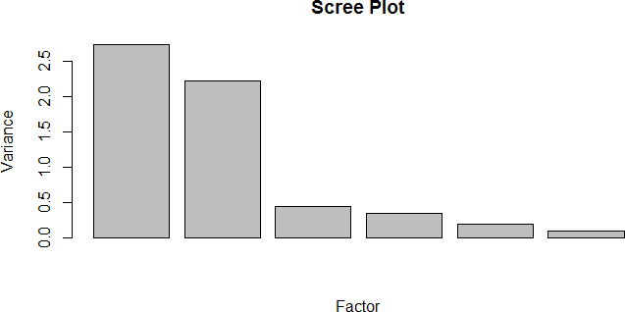
FACTOR ANALYSIS
Step 4: Determine the number of Factors
barplot(variance, xlab = "Factor", ylab = 'Variance', main = "Scree Plot“)
3. Based on Scree plot: Plot of the eigen values against the number of factors in order of extraction. The number of factors is identified based on slope change of scree plot
Number of factors selected : 2
39

Slide 38
FACTOR ANALYSIS
Step 5: Calculate Factor Scores
mymodel = factanal(myzdata, 2)
 | Component
 | 1 | 2
x1 | 0.968 | 0.000
x2 | 0.000 | 0.749
x3 | 0.898 | -0.140
x4 | 0.000 | 0.784
x5 | -0.887 | 0.236
x6 | 0.000 | 0.830
Interpretation is difficult when the variables are evenly loaded on many factors Solution: Rotation

Slide 39
FACTOR ANALYSIS
Step 5: Calculate Factor Scores: Rotation
A process by which a solution is made more interpretable without changing its underlying mathematical properties.
Types of rotations
Orthogonal rotation
Oblique rotation
Orthogonal rotation
Restricts the rotated factors to being uncorrelated
Oblique rotation
allows the rotated factors to be correlated

Slide 40
FACTOR ANALYSIS
Step 5: Calculate Factor Scores: Rotation
A process by which a solution is made more interpretable without changing its underlying mathematical properties.
Commonly used rotation : Orthogonal rotation
Commonly used orthogonal rotation : varimax rotation
Try to achieve factors with a few large loadings and as many near – zero loadings as possible

Slide 41
FACTOR ANALYSIS
Step 5: Calculate Factor Scores: Rotation
myrotatedmodel = factanal(myzdata, 2, rotation = "varimax", scores = "regression")
myrotatedmodel
 | Component
 | 1 | 2
x1 | 0.968 | 0.000
x2 | 0.000 | 0.749
x3 | 0.898 | -0.140
x4 | 0.000 | 0.784
x5 | -0.887 | 0.236
x6 | 0.000 | 0.830

Slide 42
FACTOR ANALYSIS
Step 5: Interpret Components – Eigen Vectors
 | Component
 | 1 | 2
x1 | 0.968 | 0.000
x2 | 0.000 | 0.749
x3 | 0.898 | -0.140
x4 | 0.000 | 0.784
x5 | -0.887 | 0.236
x6 | 0.000 | 0.830
Component 1 is correlated with x1, x3 & x5
Component 2 is correlated with x2, x4 & x6

Slide 43
FACTOR ANALYSIS
Step 5: Interpret Components
 | Component
 | 1 | 2
Prevention of Cavities | 0.968 | 0.000
x2 | 0.000 | 0.749
Strong Gum | 0.898 | -0.140
x4 | 0.000 | 0.784
Non Prevention of Tooth Decay | -0.887 | 0.236
x6 | 0.000 | 0.830
Interpretation
Component 1 represents the health related benefits

Slide 44
FACTOR ANALYSIS
Step 5: Interpret Components
 | Component
 | 1 | 2
Prevention of Cavities | 0.968 | 0.000
Shiny Teeth | 0.000 | 0.749
Strong Gum | 0.898 | -0.140
Fresh Breath | 0.000 | 0.784
Non Prevention of Tooth Decay | -0.887 | 0.236
Attractive Teeth | 0.000 | 0.830
Interpretation
Component 2 represents the social related benefits

Slide 45
FACTOR ANALYSIS
Step 6: Reduced Data Set
output = myrotatedmodel$scores
output
Respondent | Factor1 | Factor2 | Respondent | Factor1 | Factor2
1 | 1.3046 | -0.2413 | 16 | 0.8934 | -0.342
2 | -1.2952 | -0.2556 | 17 | 0.5714 | -0.5502
3 | 1.1629 | -0.7569 | 18 | 1.501 | -0.24
4 | 0.1747 | 1.0108 | 19 | -0.9845 | -0.6938
5 | -1.428 | -1.3608 | 20 | -0.4187 | 1.259
6 | 0.9864 | -0.2511 | 21 | -1.3132 | -0.8042
7 | 0.4605 | -0.9084 | 22 | 0.5706 | -0.0143
8 | 1.1867 | -0.0515 | 23 | -0.9855 | -0.1067
9 | -0.7678 | -0.6358 | 24 | 0.0209 | 1.7277
10 | -1.1191 | 1.3473 | 25 | 0.8821 | -0.1881
11 | 1.0738 | -0.6495 | 26 | -0.3011 | 1.5195
12 | -1.0785 | -0.1976 | 27 | 0.4675 | -0.2914
13 | 1.3796 | -0.6989 | 28 | -0.5606 | 0.7776
14 | 0.0978 | 1.2286 | 29 | 0.1111 | 2.1146
15 | -1.394 | -0.7847 | 30 | -1.1988 | -0.9623

Slide 46
MARKET BASKET
ANALYSIS
46

Slide 47
MARKET BASKET ANALYSIS
A modeling technique based upon the logic that if a customer buy a certain group of items, he is more (or less) likely to buy another group of items
Example:
Those who buy cigarettes are more likely to buy match box also.
47

Slide 48
MARKET BASKET ANALYSIS
Association Rule Mining:
Developing rules that predict the occurrence of of an item based on the
occurrence of other items in the transaction
Example
Id | Items
1 | Milk, Bread
2 | Bread, Biscuits, Toys, Eggs
3 | Milk, Biscuits, Toys, Fruits
4 | Bread, Milk, Toys, Biscuits
5 | Milk, Bread, Biscuits, Fruits
{Milk, Bread}
{Biscuits} with probability = 2 / 3
48

Slide 49
MARKET BASKET ANALYSIS
Itemset:
A collection of one or more items
k – itemset
An itemset consisting of k items
Id | Items
1 | Milk, Bread
2 | Bread, Biscuits, Toys, Eggs
3 | Milk, Biscuits, Toys, Fruits
4 | Bread, Milk, Toys, Biscuits
5 | Milk, Bread, Biscuits, Fruits
49

Slide 50
MARKET BASKET ANALYSIS
Support count:
Frequency of occurrence of an itemset
Example
{Milk, Bread, Biscuits} = 2
Id | Items
1 | Milk, Bread
2 | Bread, Biscuits, Toys, Eggs
3 | Milk, Biscuits, Toys, Fruits
4 | Bread, Milk, Toys, Biscuits
5 | Milk, Bread, Biscuits, Fruits
50

Slide 51
MARKET BASKET ANALYSIS
Support :
Proportion or fraction of transaction that contain an itemset
Example
{Milk, Bread, Biscuits} = 2 / 5
Id | Items
1 | Milk, Bread
2 | Bread, Biscuits, Toys, Eggs
3 | Milk, Biscuits, Toys, Fruits
4 | Bread, Milk, Toys, Biscuits
5 | Milk, Bread, Biscuits, Fruits
Frequent Itemset
An itemset whose support is greater than or equal to minimum support
121

Slide 52
MARKET BASKET ANALYSIS
Confidence
Conditional probability that an item will appear in transactions that contain another
items
Example
Confidence that Toys will appear in transaction containing Milk & Biscuits
= {Milk, Biscuits, Toys} / {Milk, Biscuits} = 2 / 3 = 0.67
Id | Items
1 | Milk, Bread
2 | Bread, Biscuits, Toys, Eggs
3 | Milk, Biscuits, Toys, Fruits
4 | Bread, Milk, Toys, Biscuits
5 | Milk, Bread, Biscuits, Fruits

Slide 53
MARKET BASKET ANALYSIS
Association Rule Mining
Frequent Itemset Generation
Fix minimum support value
Generate all itemsets whose support ≥ minimum support
Rule Generation
Fix minimum confidence value
Generate high confidence rules from each frequent itemset

Slide 54
MARKET BASKET ANALYSIS
Frequent Itemset Generation: Apriori Algorithm
Fix minimum support count
Generate all itemsets of length = 1
Calculate the support for each itemset
Eliminate all itemsets with support count < minimum support count
Repeat steps c & d for itemsets of length = 2, 3, ---

Slide 55
MARKET BASKET ANALYSIS
Frequent Itemset Generation: Apriori Algorithm
Example:
Minimum Support count = 2
Id | Items
1 | A,C,D
2 | B,C,E
3 | A,B,C,E
4 | B,E
5 | A,E
6 | A,C,E

Slide 56
MARKET BASKET ANALYSIS
Frequent Itemset Generation: Apriori Algorithm
Example:
Minimum Support count = 2 Step 1:
Generate itemsets of length = 1 & calculate support
Item | Support count
A | 4
B | 3
C | 4
D | 1
E | 5

Slide 57
MARKET BASKET ANALYSIS
Frequent Itemset Generation: Apriori Algorithm
Example:
Minimum Support count = 2 Step 2:
eliminate itemsets with support count < minimum support count (2)
Item | Support count
A | 4
B | 3
C | 4
D | 1
E | 5

Slide 58
MARKET BASKET ANALYSIS
Frequent Itemset Generation: Apriori Algorithm
Example:
Minimum Support count = 2 Step 2:
eliminate itemsets with support count < minimum support count (2)
Item | Support count
A | 4
B | 3
C | 4
E | 5

Slide 59
MARKET BASKET ANALYSIS
Frequent Itemset Generation: Apriori Algorithm
Example:
Minimum Support count = 2 Step 3:
generate itemsets of length = 2
Item | Support count
A, B | 1
A, C | 3
A,E | 3
B, C | 2
B, E | 3
C,E | 3

Slide 60
MARKET BASKET ANALYSIS
Frequent Itemset Generation: Apriori Algorithm
Example:
Minimum Support count = 2 Step 4:
eliminate itemsets with support count < minimum support count (2)
Item | Support count
A, B | 1
A, C | 3
A,E | 3
B, C | 2
B, E | 3
C,E | 3

Slide 61
MARKET BASKET ANALYSIS
Frequent Itemset Generation: Apriori Algorithm
Example:
Minimum Support count = 2 Step 4:
eliminate itemsets with support count < minimum support count (2)
Item | Support count
A, C | 3
A,E | 3
B, C | 2
B, E | 3
C,E | 3

Slide 62
MARKET BASKET ANALYSIS
Frequent Itemset Generation: Apriori Algorithm
Example:
Minimum Support count = 2 Step 5:
generate itemsets of length = 3
Item | Support count
A, C, E | 2
B, C, E | 2
Step 6:
generate itemsets of length = 4
Itemset | Support Count
A, B, C, E | 1

Slide 63
MARKET BASKET ANALYSIS
Frequent Itemset Generation: Apriori Algorithm
Example:
Minimum Support count = 2 Result:
Item | Support count | Support
A, C, E | 2 | 0.33
B, C, E | 2 | 0.33
A , C | 3 | 0.50
A , E | 3 | 0.50
B,C | 2 | 0.33
B,E | 3 | 0.50
C,E | 3 | 0.50

Slide 64
MARKET BASKET ANALYSIS
Association Rule Mining: Apriori Algorithm
Example:
Minimum Support = 0.50 Minimum Confidence = 0.5
Item | Support count | Support
A, C, E | 2 | 0.33
B, C, E | 2 | 0.33
A , C | 3 | 0.50
A , E | 3 | 0.50
B,C | 2 | 0.33
B,E | 3 | 0.50
C,E | 3 | 0.50

Slide 65
MARKET BASKET ANALYSIS
Association Rule Mining: Apriori Algorithm
Example:
Minimum Support = 0.50 Minimum Confidence = 0.5
Item | Support | Confidence
A C | 0.50 | 0.75
A E | 0.50 | 0.75
B E | 0.50 | 1.00
C E | 0.50 | 0.75
C A | 0.50 | 0.75
E A | 0.50 | 0.60
E B | 0.50 | 0.60
E C | 0.50 | 0.60

Slide 66
MARKET BASKET ANALYSIS
Association Rule Mining: Other Measures
Lift
Lift (A C) = Confidence (A C) / Support (C) Example
Item | Confidence | Support | Lift
A C | 0.75 | C = 0.67 | 1.12
A E | 0.75 | E = 0.83 | 0.93
Criteria : Lift ≥ 1
Lift (A , C) = 1.12 > Lift (A , E) indicates that A has a greater impact on the frequency of C than it has on the frequency of E

Slide 67
MARKET BASKET ANALYSIS
R Code
Reading the file and variables
>target = mydata$items
>ident = mydata$Id
Making transactions
>library(arules)
>transactions = as(split(target, ident),”transactions”)
Generating rules
>library(arules)
>myrules = apriori(transactions, parameter = list(support = 0.5, confidence = 0.25, minlen = 2))
Displaying rules
>myrules
>inspect(myrules)

Slide 68
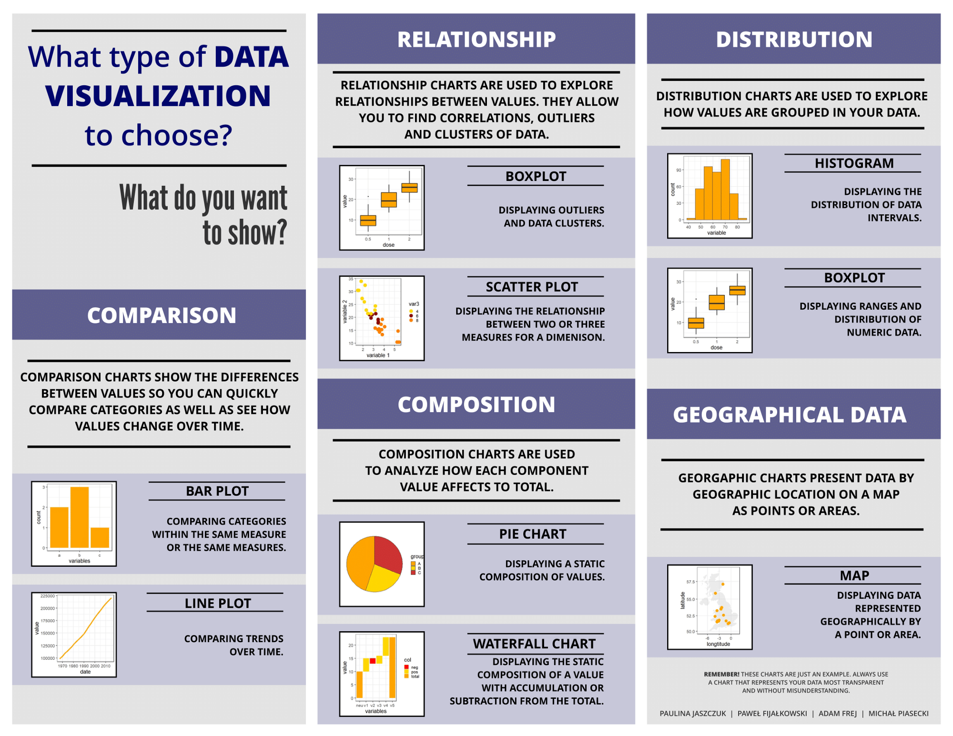
CHEAT SHEET
68

Slide 69
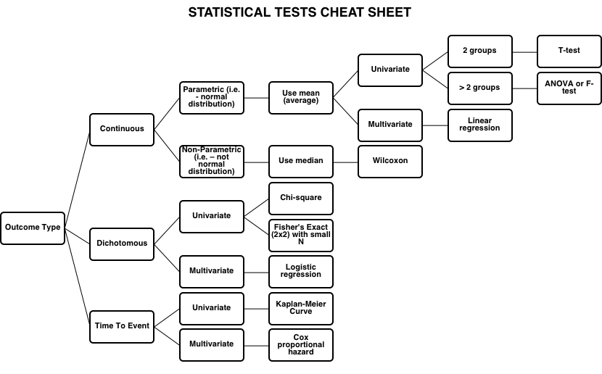
CHEAT SHEET
69

Slide 70
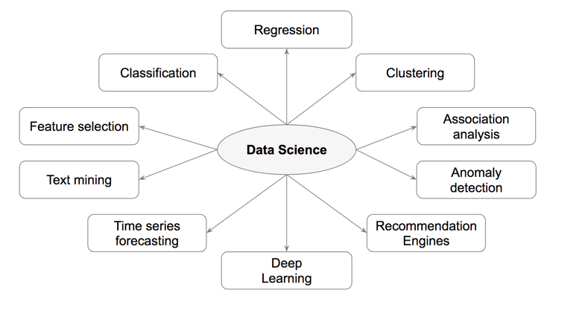
CHEAT SHEET
70

Slide 71
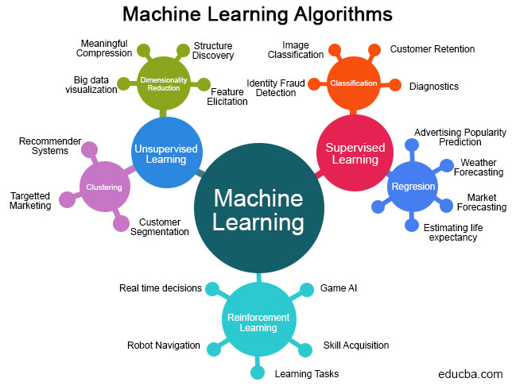
CHEAT SHEET
71

Slide 72
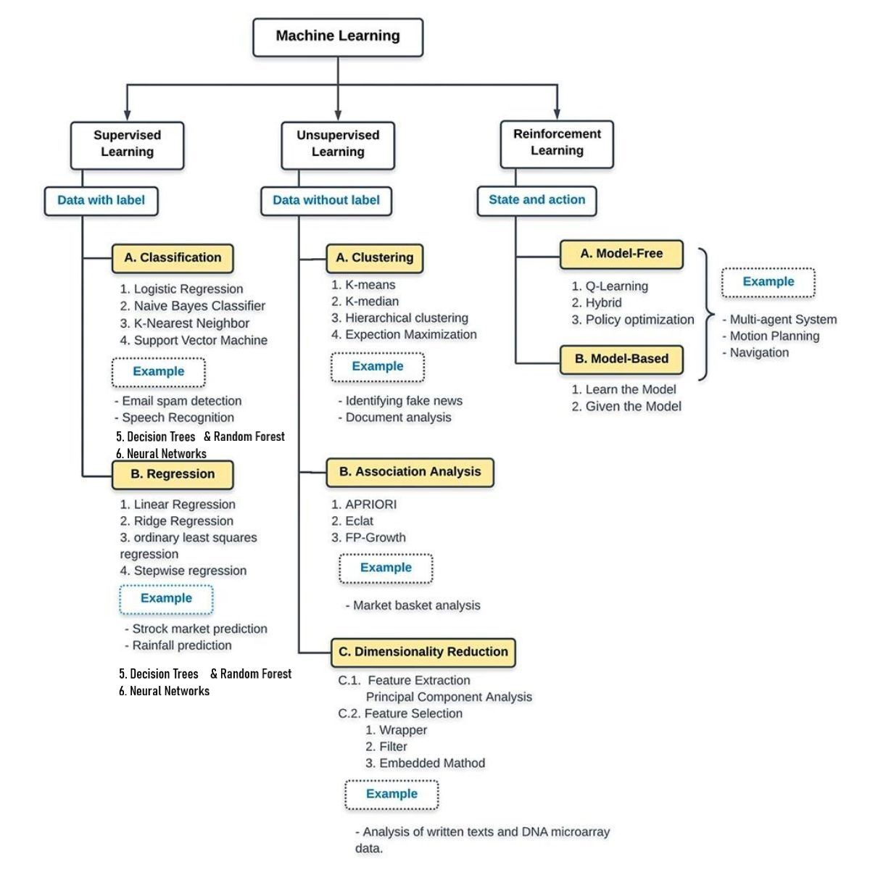
CHEAT SHEET
72

Slide 73
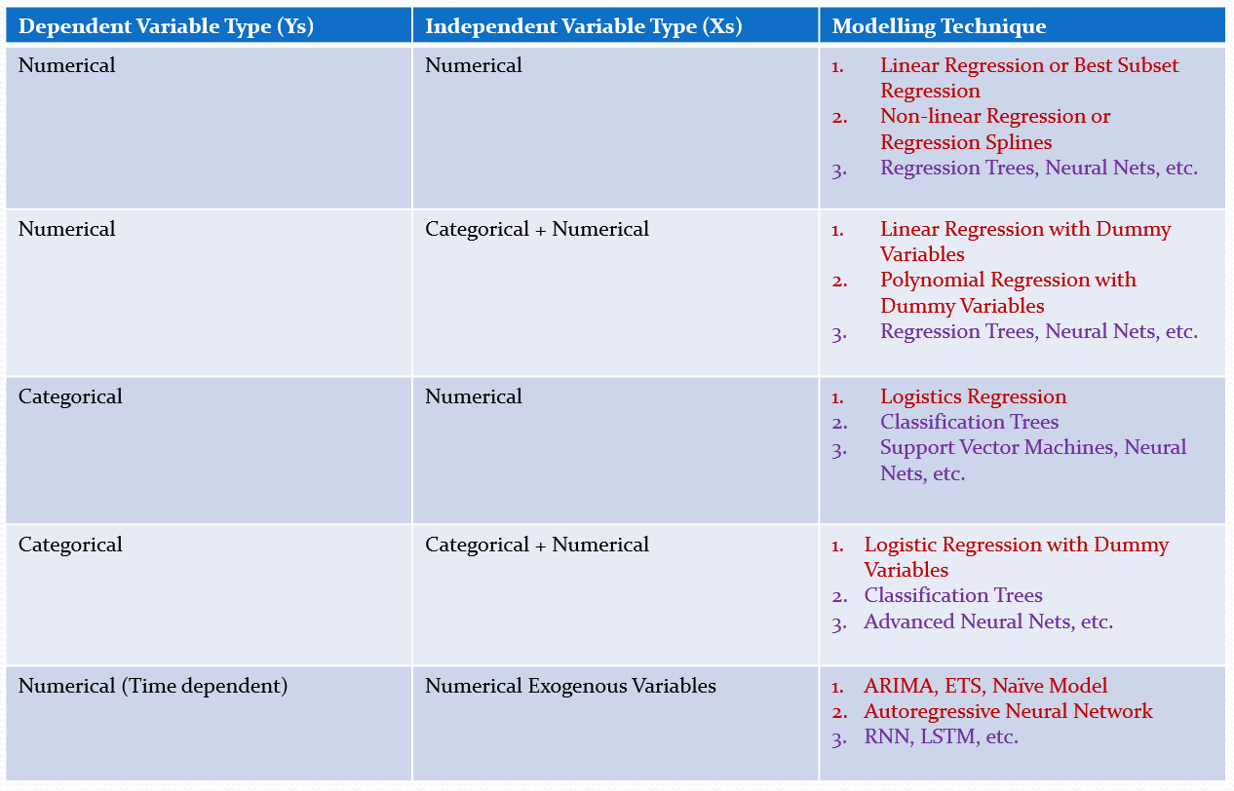
CHEAT SHEET
73

Slide 74

TEXTBOOKS & REFERENCES
74

Slide 75

END OF MULTIVARIATE DATA ANALYTICS COURSE

